Slide 1
Weekly Report
程文胜 2021.2.21-2.28

Slide 2
Weekly Report
Abstract
Content
End

Slide 3
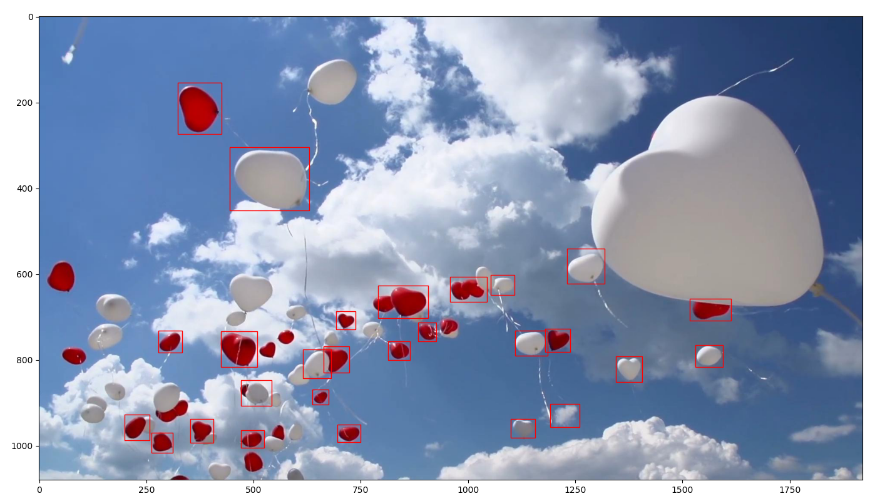
Abstract
Last week I mainly spent time on re-running GlobalTrack method to get one-shot detection results.

Slide 4
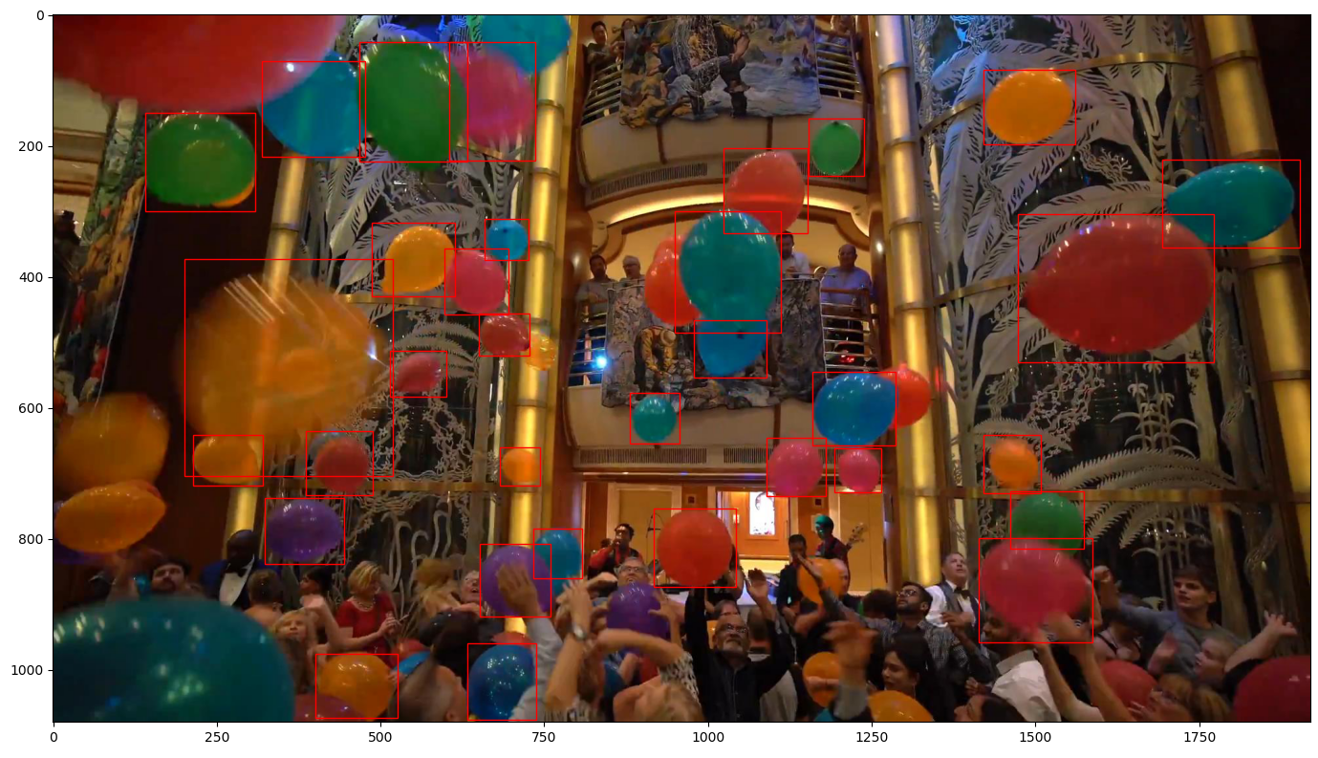
Content
Similar with earlier experiments, we randomly choose 5 boxes as the initial boxes, and then perform the one-shot GMOT task. We mainly run the experiments on those relabeled sequences.

Slide 5
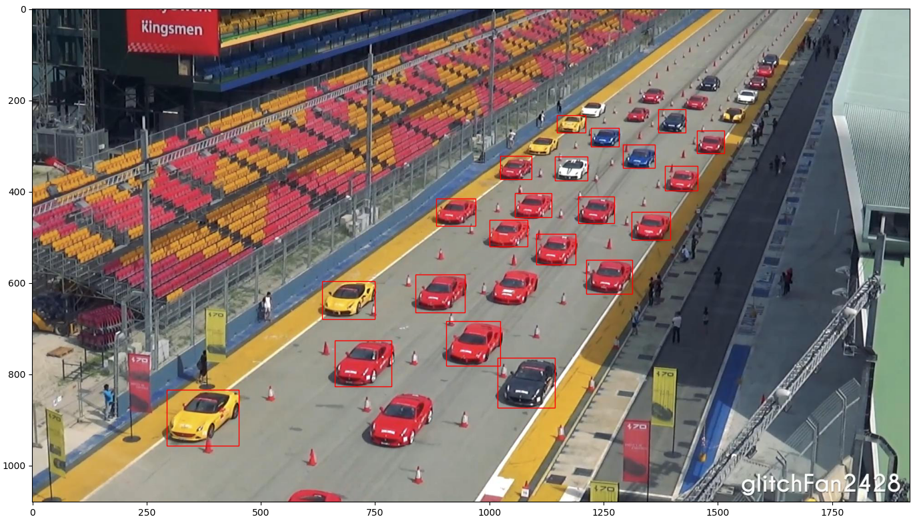
Content
The interesting thing is, even when we choose an object which has a different appearance with other objects of the same category, the one-shot detection method can still detect those objects, which supports that we should label all objects of the same category, regardless of their appearances.
One-shot detection result with a yellow car as initialization target

Slide 6
Report End
程文胜 2.28

